Slide 1
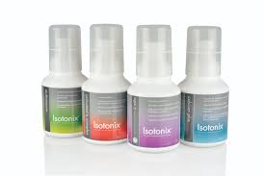
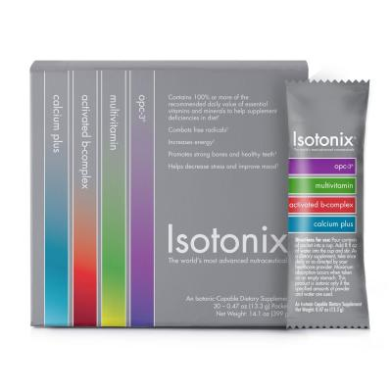
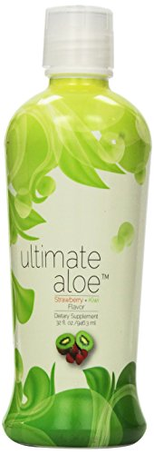
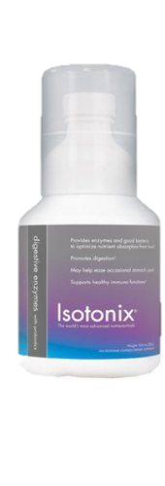
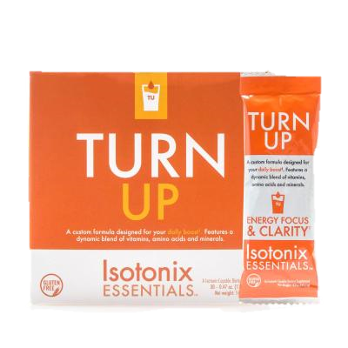
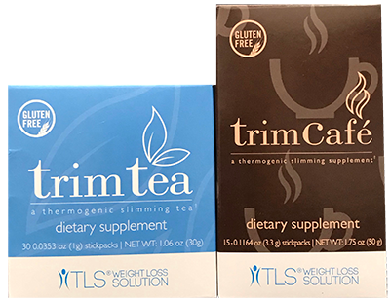
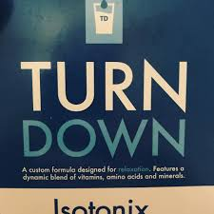
WHICH KIT
YOU?
IS RIGHT FOR
Convenient On-The-Go Packets with Four Essential customer favorites
Daily Essential Kit 90 Servings Contains:
1 Isotonix® Multivitamin 300 g bottle
1 Isotonix Activated B-Complex 300 g bottle
1 Isotonix OPC-3 300 g bottle
1 Isotonix Calcium Plus 300 g bottle
Digestive Kit Contains:
1 Ultimate Aloe Juice® Strawberry Kiwi Flavor 32 oz
1 Isotonix Digestive Enzymes with Probiotics 300mg
Isotonix Daily Essential Packets: Single Box (30 packets) Isotonix OPC-3® Isotonix® Multivitamin Isotonix® Activated B-Complex Isotonix® Calcium Plus
COST | $285.25 SGD
COST | $115.50
COST | $99.75 SGD
$575 SGD
Weigh loss Tea/Coffee:
Trim Tea :30 Packets
Trim Café 15 Packets
Sleep & Energy Drink
Isotonix Turn up Single Box 30 Packets Isotonix Turn Down Single Box 30 Packets
COST | $129.50 SGD
COST | $207.75 SGD
Credit Card Option:
Name: ________________________________________________Email: _________________________________ Phone: __________________________
Address:___________________________________________________________City: _____________________________ State: ___ Zip :____________
Credit Card #: _________________________________________________Exp Date:______________ CVV: _________________
*These statements have not been evaluated by the Food and Drug Administration. These products are not intended to diagnose, treat, cure or prevent any disease

Slide 2
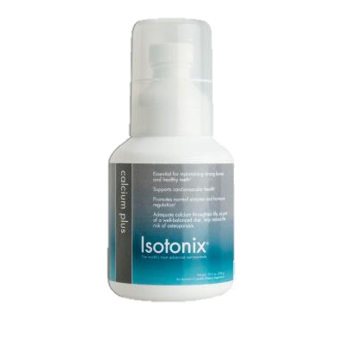
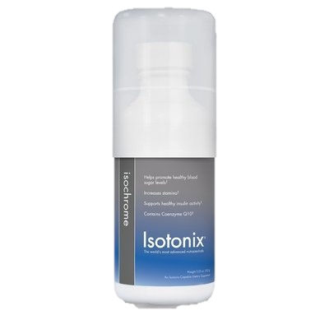
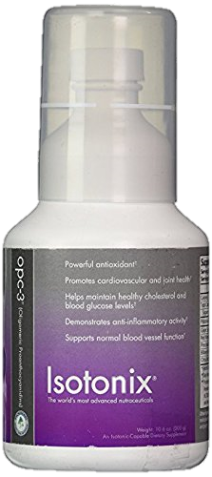
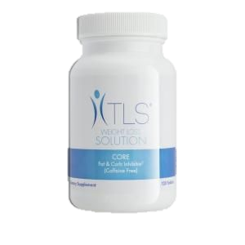
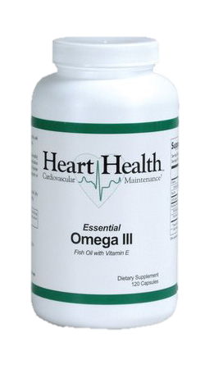
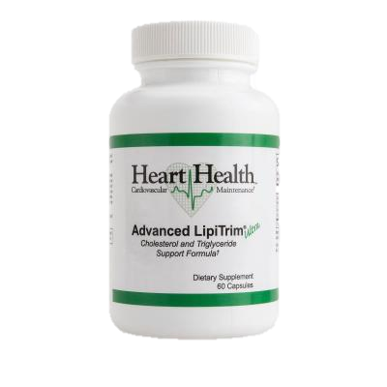
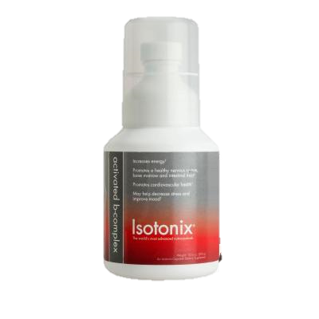
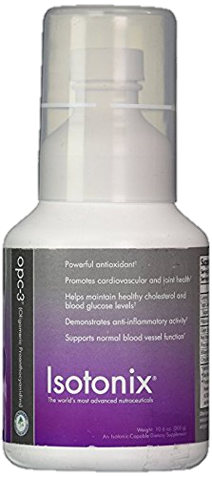
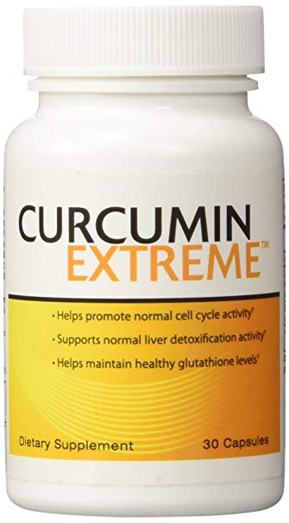
WHICH KIT
YOU?
IS RIGHT FOR
Blood Sugar Balance Contains:
1 Isotonix® Isochrome ( 30 Serving)
1 TLS CORE ( 120 Counts)
Cholesterol Maintenance Contains: 1 Heart Health™ Advanced LipiTrim™ Ultra ( 60 Capsule)
1 Heart Health™ Essential Omega III Fish Oil with Vitamin E
Healthy Blood Pressure Support:
1 Isotonix® OPC-3 ( 90 Serving) 1 Isotonix® Calcium ( 90 Serving)
COST | $155.25 SGD
COST | $162.5 SGD
COST | $155.75 SGD
RM1618
Stress Kit Contains:
1 Isotonix® OPC-3 ( 90 Serving)
1 Isotonix® B Complex ( 90 Serving)
Seasonal Kit
1 Isotonix® OPC-3 ( 90 Serving) 1 Curcumin Extreme (30 Servings
COST | $196.00 SGD
COST | $190.75 SGD
Credit Card Option:
Name: ________________________________________________Email: _________________________________ Phone: __________________________
Address:___________________________________________________________City: _____________________________ State: ___ Zip :____________
Credit Card #: _________________________________________________Exp Date:______________ CVV: _________________
*These statements have not been evaluated by the Food and Drug Administration. These products are not intended to diagnose, treat, cure or prevent any disease

Slide 3
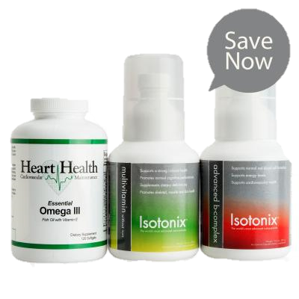
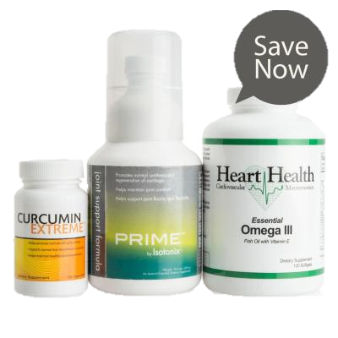
WHICH KIT
YOU?
IS RIGHT FOR
Convenient On-The-Go Packets with Four Essential customer favorites
Daily Essential Kit 90 Servings Contains:
1 Isotonix® Multivitamin 300 g bottle
1 Isotonix Activated B-Complex 300 g bottle
1 Isotonix OPC-3 300 g bottle
1 Isotonix Calcium Plus 300 g bottle
Isotonix Daily Essential Packets: Single Box (30 packets) Isotonix OPC-3® Isotonix® Multivitamin Isotonix® Activated B-Complex Isotonix® Calcium Plus
Digestive Kit Contains:
1 Ultimate Aloe Juice® Strawberry Kiwi Flavor 32 oz
1 Isotonix Digestive Enzymes with Probiotics 300mg
COST | $285.25 SGD
COST | $115.50
COST | $99.75 SGD
$575 SGD
Optimal Wellness Kitt Contains :
1 Isotonix® Multivitamin 300 g bottle
1 Isotonix Activated B-Complex 300 g bottle
Omega 3
Join Health Contains:
Isotonix Prime Joint Heart Health Omega 3 ( 120 counts) Curcumin Extreme (30 Servings
COST | $225.25
COST | $251.25
Credit Card Option:
Name: ________________________________________________Email: _________________________________ Phone: __________________________
Address:___________________________________________________________City: _____________________________ State: ___ Zip :____________
Credit Card #: _________________________________________________Exp Date:______________ CVV: _________________
*These statements have not been evaluated by the Food and Drug Administration. These products are not intended to diagnose, treat, cure or prevent any disease

Slide 4
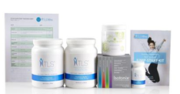
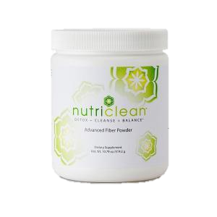
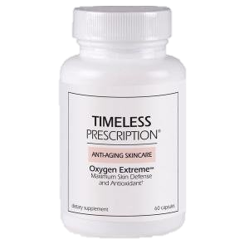
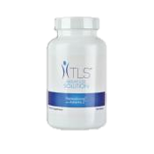
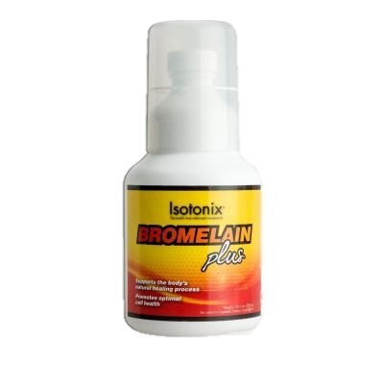
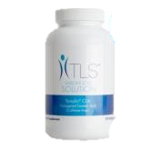
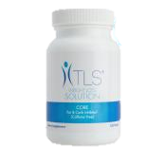
WHICH KIT
YOU?
IS RIGHT FOR
TLS® 30 Day Jump Start Kit: NutriClean Fiber Powder; 1 TLS CORE, Isotonix Daily Essential Pk, 2 TLS Nutrition Shakes – 1 Vanilla; 1 Chocolate; Challenge Guide; Tracking Sheet; Shaker Bottle and Button
Complete Detox Kit
1 Ultimate Aloe Juice® Strawberry Kiwi Flavor 32 oz
1 NutriClean Fiber Powder;
1 Timeless Oxygen Extreme ((30 Servings
Trim Tea / Trim Cofe ( Pick 1)
3 Trim Tea Box or 3 Trim Café Box
COST | $170.75 SGD
COST | $194.25
COST | $323.25 SGD
$575 SGD
The Fat Burner Kit: ( Pick 1 Combo)
CLA And ThermoChrome with Trim Tea/ Trim Café
CLA And Garcinia Combogia with Trim Tea/ Trim Cafe
Workout Recovery Kit: 1 Isotonix® B Complex ( 90 Serving)
1 Isotonix® Bromelain ( 90 Serving)
1 NutriClean Fiber Powder;
COST | $221.75
COST | $256.25 SGD
Credit Card Option:
Name: ________________________________________________Email: _________________________________ Phone: __________________________
Address:___________________________________________________________City: _____________________________ State: ___ Zip :____________
Credit Card #: _________________________________________________Exp Date:______________ CVV: _________________
*These statements have not been evaluated by the Food and Drug Administration. These products are not intended to diagnose, treat, cure or prevent any disease

